Slide 1
MELVIN OLIVE III
The Interview web Application

Slide 2





Programming Languages:
Python
HTML
CSS
FLASK(framework)
JAVASCRIPT
JSON
JQUERY

Slide 3
PROJECT OUTLINE:
HTML Functionality :
HomePage
Username/Login Functionality
Navigation bar with FAQ page and About page
Faq Page
Questions and Answers
About Page
Interviews Page
User information
Candidate Page
Create new candidates through this page
d. HomePage
2. Sign Up Process

Slide 4
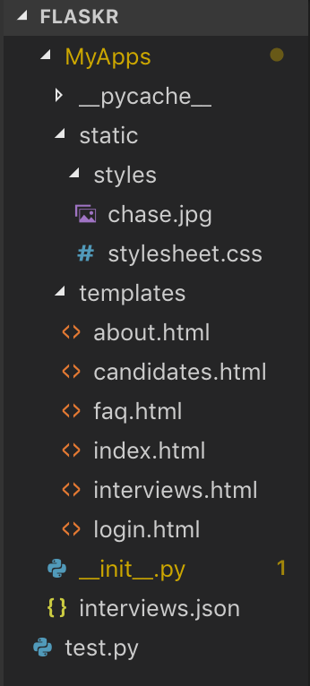
PROJECT STRUCTURE
The project is developed using the Flask framework.
Within this Flask framework I utilized different programming languages to develop the project.
Static folders are designated for styling the application.
The template folder is designated for all html functionality or html files
Python files are designated to go under the template folder

Slide 5
How I got Started
I began developing the project with HTML/CSS two programming languages I already had familiarity with.
Next began the use of Python some javascript and eventually Json data aggregated from a html form.

Slide 6
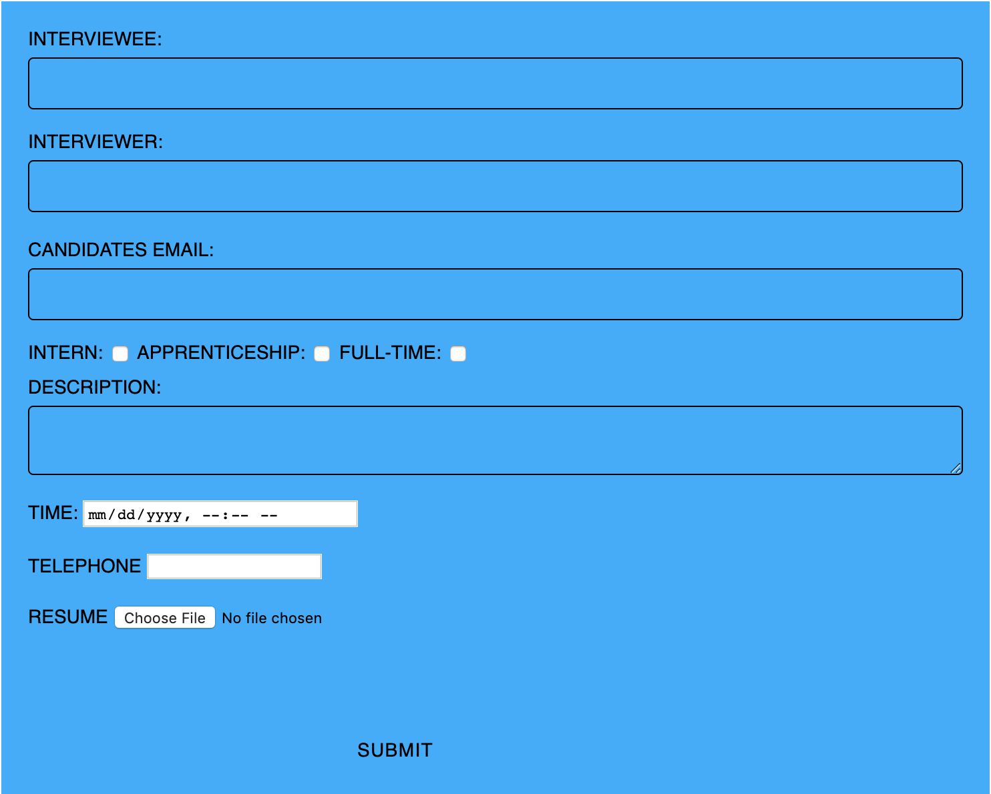
Where Does Everything Tie in?
The central key component of the project is a active HTML form.

Slide 7

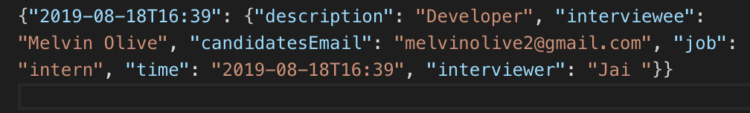
Information
The HTML form passes information from the user to a local database.

Slide 8
How did I get User Data:
By using Jinja Loops I was able to create an active form from a HTML file to a python file which eventually added data to a JSON file.

Slide 9
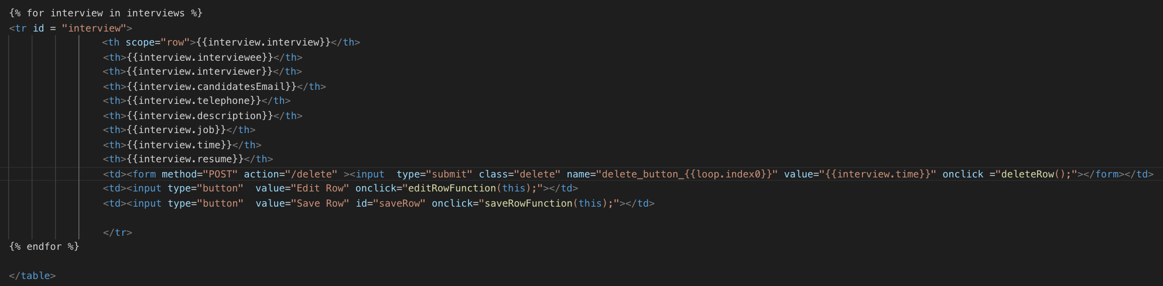
] Jinja Loops
By utilizing a button type for submit once the user clicks the submit button the form data will be used by the JINJA loops
Next the form data will be posted to python for use to store in a json file.

Slide 10
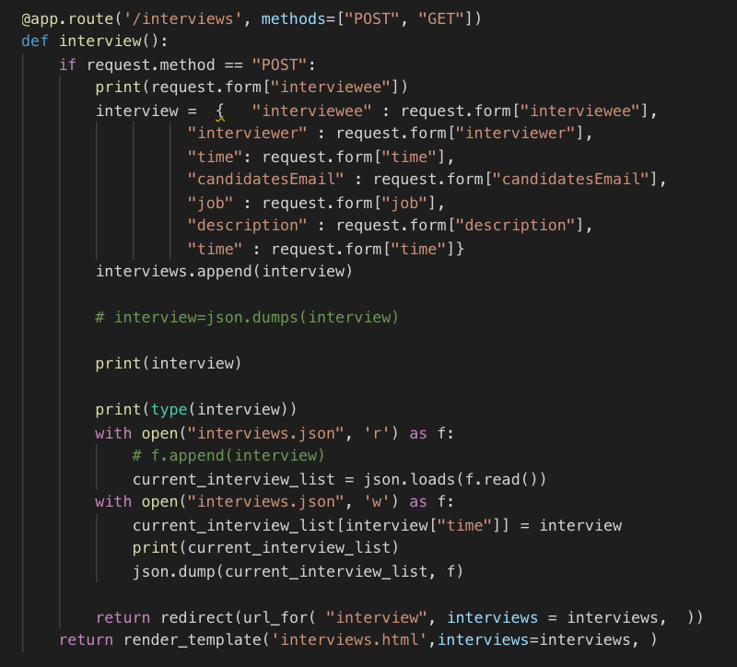
How did I get User Data:
By using Jinja Loops I was able to create an active form from a HTML file to a python file which eventually added data to a JSON file.

Slide 11
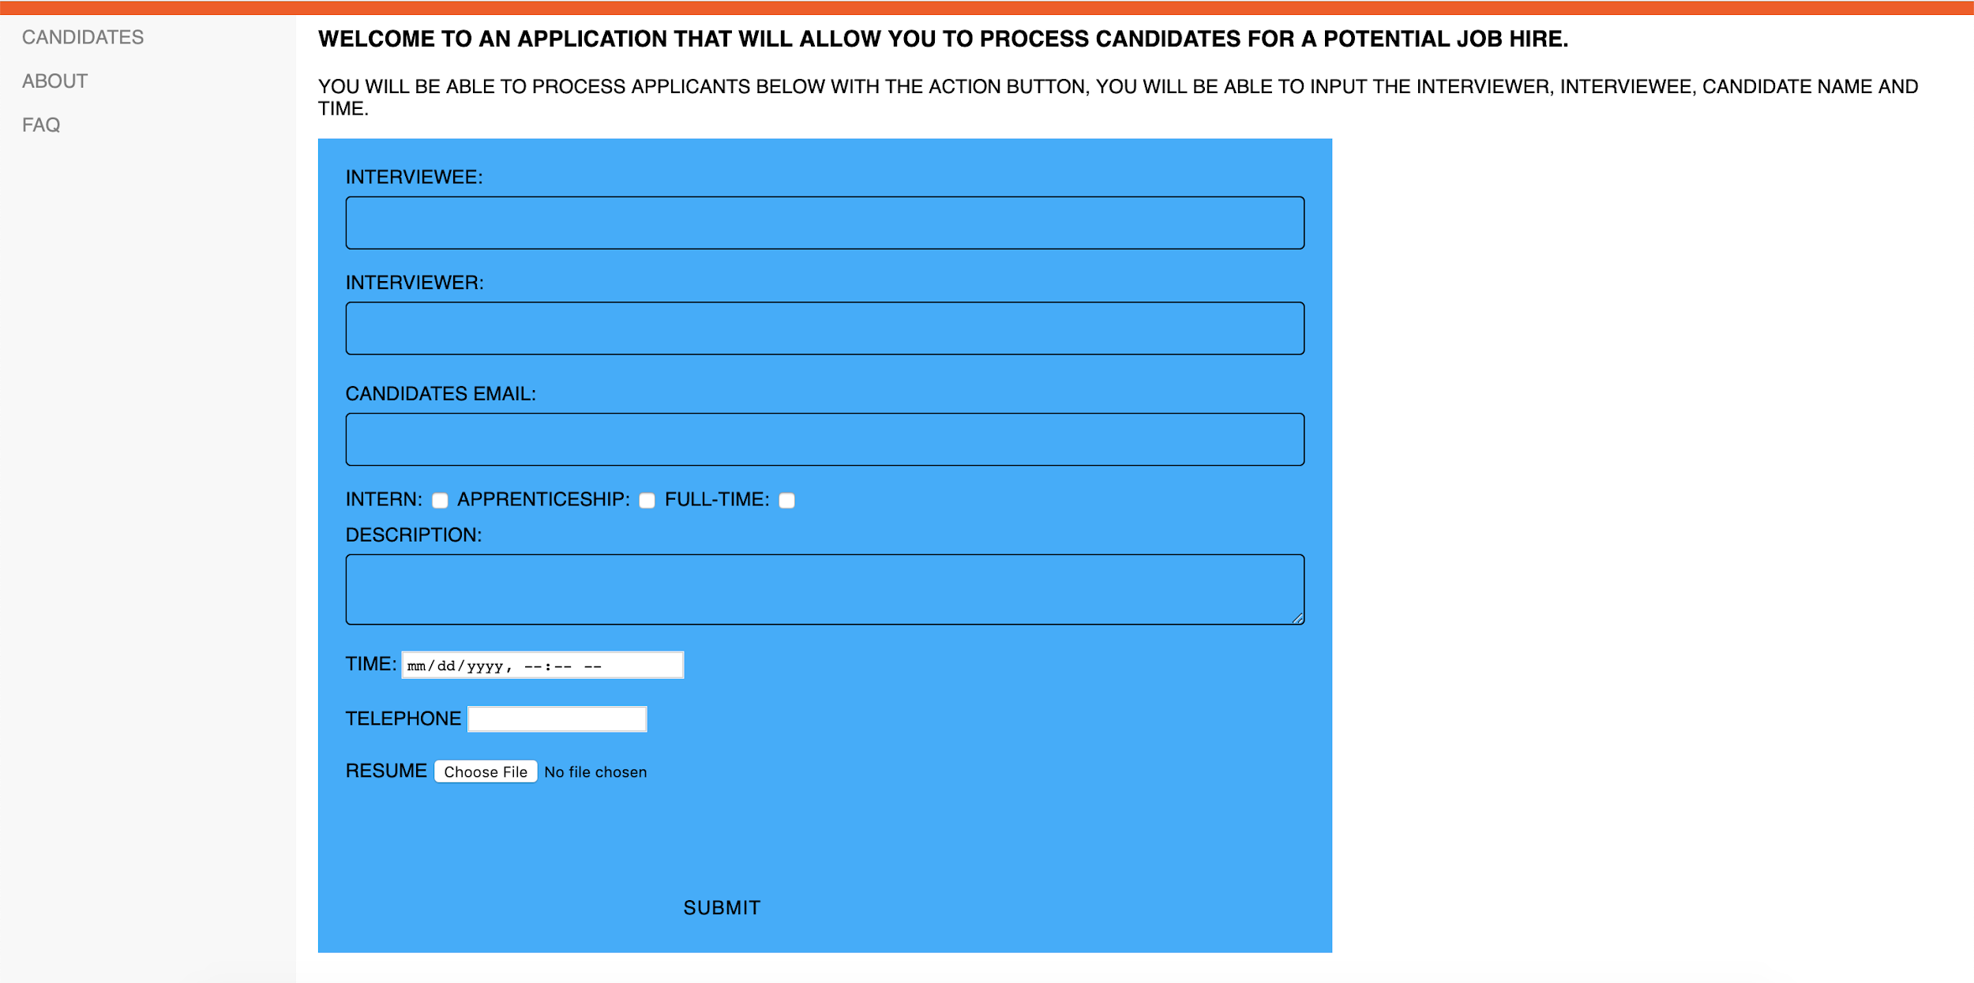


Slide 12
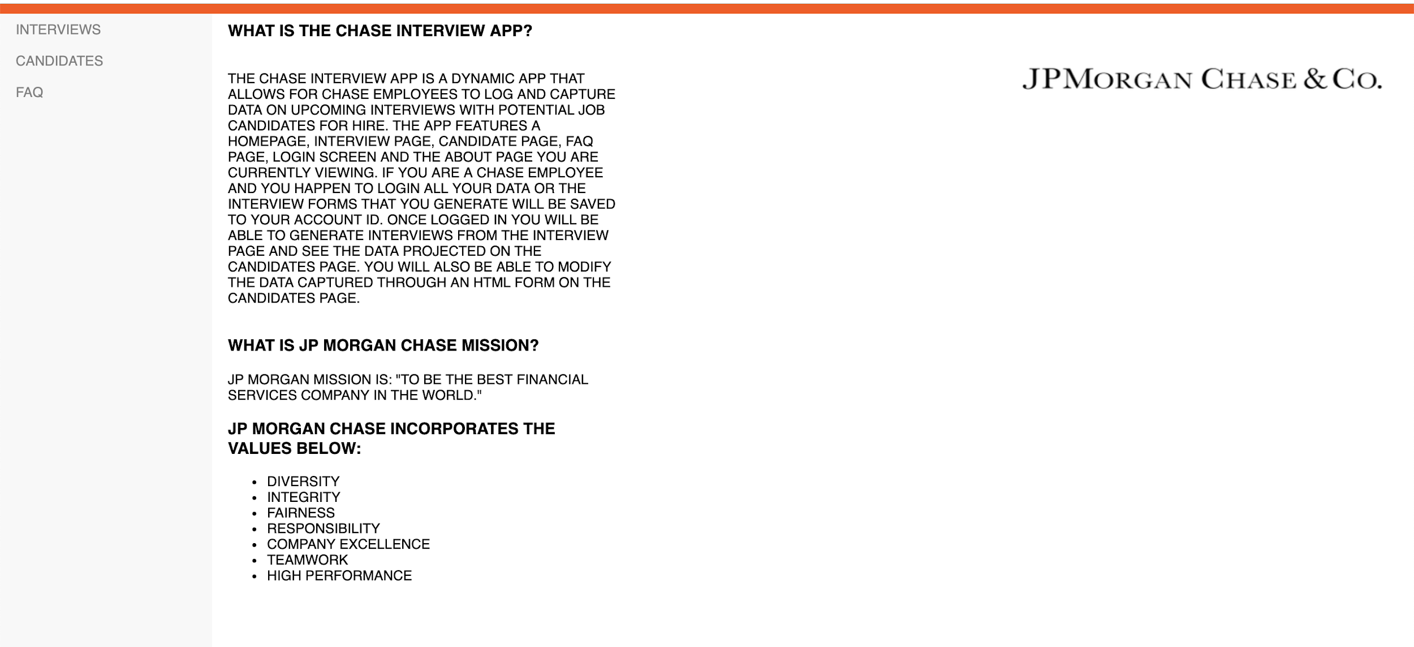

Slide 13
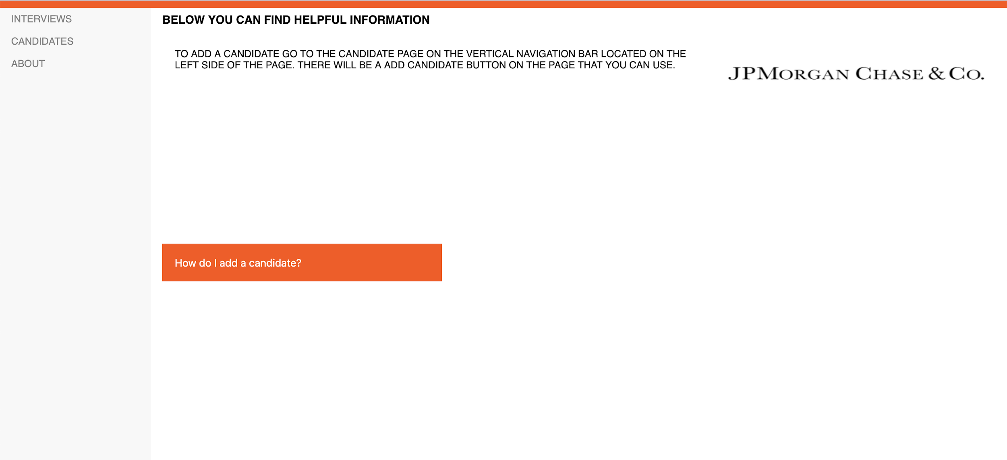

Slide 14
CHALLENGES:
Aggregating user information from a HTML table.
Ability to store aggregated user information from a HTML table without using SQL or PHP.
Login/sign in functionality
The use of python, javascript, json and the Flask framework without any previous python experience.

Slide 15
WHAT’S NEXT?
Now that I am able to take in user information there needs to be a login functionality along with the ability to edit and delete the data will be added to further make this a usable application.

